Slide 1
Taming the herd linear video at comcast
September, 10, 2019
Evan Zelkowitz
Thanks to: Robert Butts, Chris Lemmons, and Jamie Panagos

Slide 2
About the Speaker
Evan Zelkowitz – Software Engineer
Comcast CDN
Github: ezelkow1
Apache: eze@apache.org
My engineering career has always been in the consumer entertainment industry. After working at Dish Network for 11 years with a focus on the driver/kernel and application interface layer for set top boxes I wanted a change and came to Comcast ~2 years ago to the CDN team.
I focus mainly on the caching layer with apache trafficserver, doing debug and development and working with the SRE team for new features and deployments

Slide 3
What is a herd?

Slide 4
The Thundering herd
When multiple clients request the same content before it has been cached
Notes:
What is a thundering herd?

Slide 5
Optimal cases

Slide 6
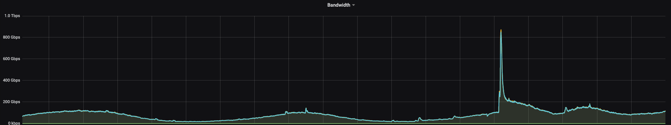
Static Content
Request comes in from multiple clients simultaneously for the same content
i.e. Steam pushes out an update for a popular game
Original requests start to populate the cache, meanwhile some clients slip through to the origin
In a short time the cache is full and no more herd
New PlayerUnknown’s BattleGrounds Update
Notes:
Maybe try to find steam graph of new content push

Slide 7
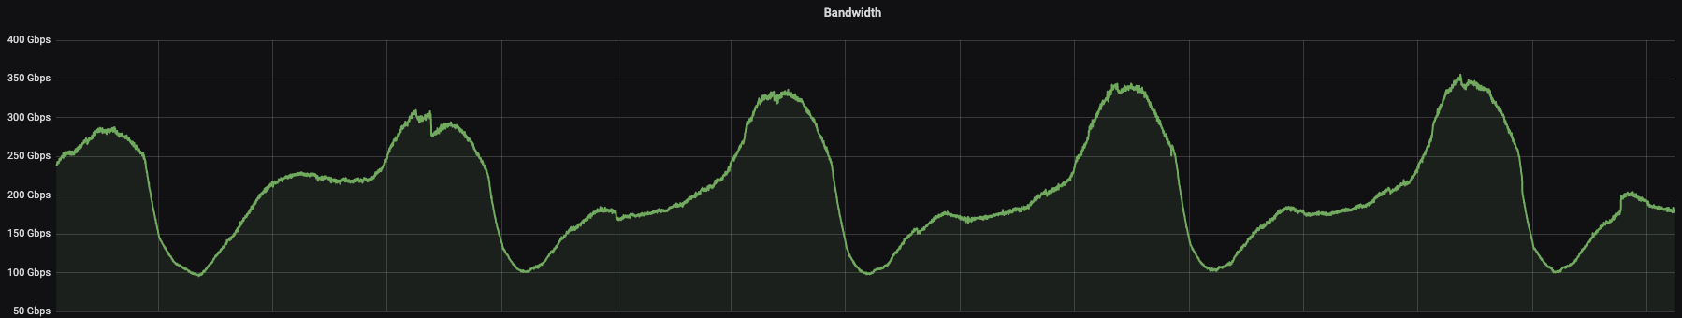
Linear Video
Multiple clients all request the same new content at the same time
i.e. New video asset from a live playlist of a live channel that rolls every couple of seconds
Each set of clients come back to request new, un-cached assets, every couple seconds
Linear video is a herd generation machine
Sample linear video service, follows normal viewing patterns

Slide 8
Optimal Flow (in our two tier architecture):
Clients open connections to edges (first tier)
Edge accepts request
Opens connection to Mid (second tier)
Waits for reply from Mid
Remaining duplicate requests go to Edge
Edge recognize duplicate requests
Edge waits for data from initial request before serving duplicate requests (in parallel, Read while Writer ATS setting)
Mid accepts request from Edge
Mid opens connection to origin
Mid recognizes duplicate Edge requests
Mid waits for data from initial request before serving duplicate Edge requests
In optimal scenario:
Origin quickly responds to Mids
Mids fill cache and quickly respond to Edges
Edges to clients
Profit!!

Slide 9
When things go wrong

Slide 10
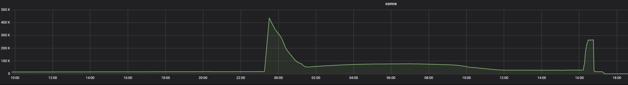
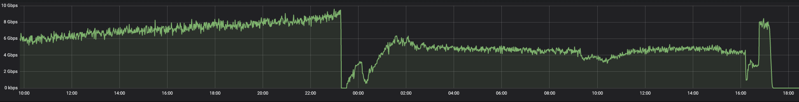
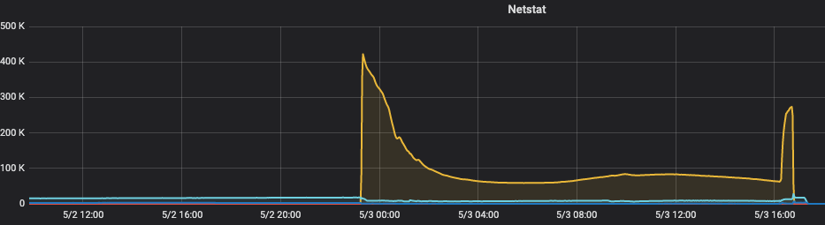
Connections back up in close_wait state

Slide 11
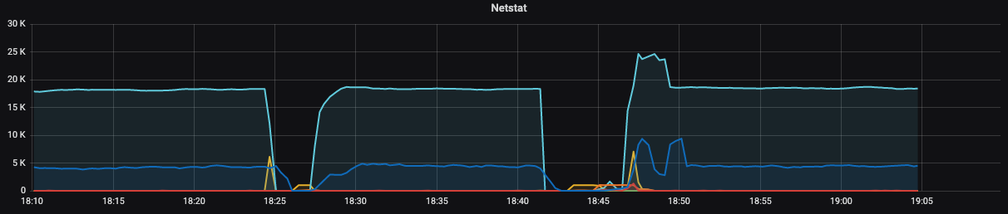
Close_wait backups. Can clearly see when ATS would crash, restart, and then immediately be hit by a barrage of connections

Slide 12
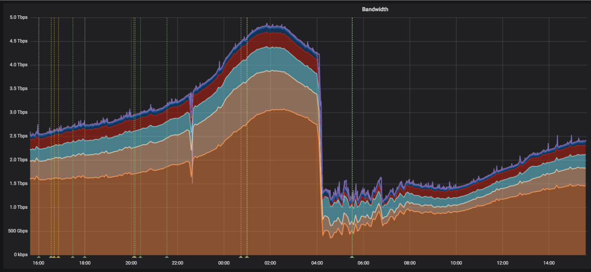
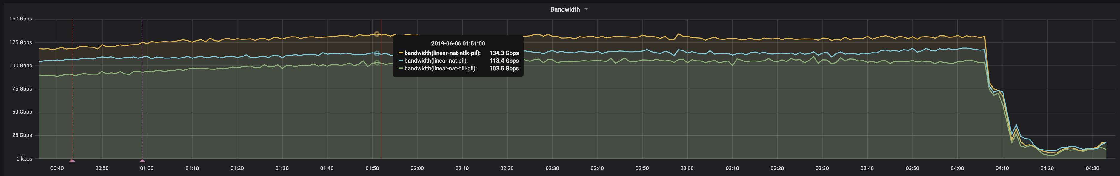

Slide 13
origin issues

Slide 14
Origin Blip
Networks are not perfect places. Sometimes, packets get lost or delayed. This isn’t frequent, but with the amount of traffic on the network, it’s occasionally inevitable. This can cause an Origin Blip.
i.e. A dropped packet between mid and origin
For this you want to make sure that all of your client retries*timeout values are longer than the total wait time that a mid can incur while waiting on an origin, otherwise you can end up with clients going to the origin before the mid has a chance to finish and be able to serve Edges

Slide 15
Origin Grey Failure
An Origin Grey Failure occurs when instead of going completely silent, an origin either struggles to keep up with the load, or fails to respond to connections. These kinds of failure are very hard to detect and manage, since they look very much like an origin that is operational, but perhaps transiently slow. If we give up too early, we’ll amplify very small network blips into outages. If we give up too late, we can create a feedback loop that disables origins by flooding them with traffic.
i.e. An origin stops responding within the total wait time of the whole path. This creates a backlog that will never decrease if the origin is under such load that it cannot recover
For this scenario you need the origin_max_connections setting in order to limit the total number of connections going upstream from Edge->Mid and Mid->Origin. Without this you can end up in a positive feedback loop of ever increasing connections

Slide 16
Example:
500k set tops make 1 request per second to 500 edges, those 500 edges talk to 10 mids
Edges can fill about 90% of requests from cache, mids as well
Set tops time out after 20 seconds
End up with 5k requests to origin per second, (0.1*500k)/10mids
Then origin goes dark for 100 seconds
Using mitigations for a blip the wait time is less than 100 seconds
Every client steps out of line for the cache and decides to go to the origin
Edges have 1mil pending requests to mids, *10 you have 10mil requests pending for the origin
Network restored
Mids start to clear 10mil backlog
Origins struggle to keep up as answers take too long back to the mids
No client gets a response within 20sec
Backlog never decreases as clients keep coming back and the origin cant keep up
Engineers must intervene to allow the origin to recover
This is the positive feedback loop since once an origin has gone down it will never be able to keep up with the subsequent flood. Depending on the size of the herd you can also start to hit the maximum amount of connections a cache can even handle which then starts to impact any other services running on it

Slide 17
ats settings

Slide 18
Read While Writer
Specifies when to enable the ability to read a cached object while another connection is completing the write to cache for that same object. The goal here is to avoid multiple origin connections for the same cacheable object upon a cache miss.
Should always have this enabled since without it you are always forcing duplicate requests to possibly go to the origin instead of reading from cache

Slide 19
Timeouts

Slide 20
Active Timeouts
Defaults are 900 (seconds) in (client), 0 out (origin or mid)
These can be fine for static content, but not for time sensitive content. A timeout of 0 on the out leg may also never be wanted in case the origin/mid side hangs for some reason you are now blocking connections that could have died and returned, this is subjective though.
We use active timeout settings closer to the length of our linear video fragments

Slide 21
Theory
Linear has 2s fragments. Hence, >2s amortized can't be watched
Case: slow client-edge connection
Result: edge (has in cache|gets from mid), client times out after 6s
Case: slow edge-mid, OR edge is slow finding available mid
Result: edge is getting from mid, edge-client times out after 6s
Case: slow mid-origin
Result: edge-client times out after 6s. Mid continues getting from origin.
After 6s, mid in times out
Determined as a heuristic to allow some clients that are interrupted or downloading in parallel
Client
Edge
mid
origin
6
7
6
7

Slide 22
Before changes we end up with connections stacking up when an origin has issues
After changes we see we are serving 200’s until we have origin issues, at which point we start disconnecting clients and origin connections

Slide 23
Connection timeouts/retries
Theory
transaction_active_timeout_in 6s
connect_attempts_timeout 2s
connect_attempts_max_retries 3
total retry time = timeout⋅retries = 6s <= active_timeout
∎ First client will get up to 2 retries
Subsequent clients get up to 3 retries before origin is marked down and clients receive an error
Client
Edge
mid
origin
6s
2s
502
2s
Client
~2s
2s
502
Notes:
These are per-origin. There are also other settings that are per ‘parent’, i.e. settings for edge to multiple mid caches

Slide 25
Negative caching origin down wait for cache

Slide 26
Negative Caching Lifetime
Negative caching allows you to serve back negative responses received from the origin for the period of negative_caching_lifetime. We found enabling this and setting it fairly conservative (in our case 2 sec) allows a bit of breathing room for origins with issues to attempt to recover instead of doing constant requests and pinning them down in an error condition
Down server cache time
Similar to negative but for unreachable origins, the amount of time ATS remembers that a host is unreachable and will not try again
Wait for cache
Default is 0. This allows traffic to be served before the cache has even been initialized, allowing requests to go through directly to the origin while a cache is still coming up. Allows clients to get data but will hit origins hard. This also prolongs the startup of a cache with many disk drives, we saw some taking an hour or more
Set to 2, Do not accept inbound connections until cache initialization has finished and been sufficiently successful that cache is enabled. This means at least one cache span is usable. If there are no spans in storage.config or none of the spans can be successfully parsed and initialized then Traffic Server will shut down. With this setting no traffic is passed until the cache is ready, which impacts clients but allows caches, in our situation, to be able to come up in under 20 minutes

Slide 27
Proxy.config.net.listen_backlog
Sets the maximum number of pending connections. If it is set to -1, Traffic Server will automatically set this to a platform-specific maximum
This is a platform specific change and dependent on your setup
Our default is 65k however we set lower
We found that during some outages decreasing this to a smaller value allowed easier connection rejection during heavy loads since we reduced the number of pending connections (we now run with a smaller value)
This can also be incorrect on some systems and default to 128, which is too low, so also good just to check your cache’s maxconn system values anyway
This is more of a trial and error and most likely not necessary. It did appear to help some during some emergencies which is why I included it

Slide 28
Read while writer

Slide 29
Enables clients to start reading an object before it has finished being fully fulfilled from an origin
Requires that headers be present in the cache for the object
Needed to determine cacheability first
proxy.config.http.background_fill_active_timeout
proxy.config.http.background_fill_completed_threshold
Both should be set to 0 to ensure that if the original client request for an object disappears that ATS will still attempt to finish fulfilling the request so it will exist in cache both for current RWR sessions as well as future attempts
This simulates something close to Squid’s collapsed forwarding implementation
Can also set proxy.config.cache.read_while_writer.max_retries and proxy.config.cache.read_while_writer_retry.delay to allow multiple retries of attempting read while writer

Slide 30
Open read/write

Slide 31
Open read retries and timeout
Specifies the amount of retries and time between retries to attempt to get a read lock on an object
Open read can have lock contention even on distinct objects, the lock is per cache span. Reads are usually very fast so not much of an issue but helps to increase waits for contention
These should be used with care when dealing with non-cacheable assets as this can serialize them
Should be used in conjunction with read while writer so that large files can be read as soon as possible

Slide 32
Open write retries and timeout
Specifies the amount of retries and time between retries to attempt to get a write lock on an object
Open write contention occurs on fresh objects. A request arrives and the cachekey is checked for existence, if it does not exist then a lock is held, request goes to the origin, and object is written
One issue is that when a write lock is retried it does not go back to the read state and so you can still end up with multiple origin requests for the same object. This is handled by collapsed forwarding (discussed later)
proxy.config.http.cache.open_write_fail_action determines action taken when retries expire
Go to Origin
Return a 502
Serve stale if object newer that proxy.config.http.cache.max_stale_age, otherwise go to origin
Return 502 on a complete miss, or serve stale if within max_stale_age
Return 502 on err or revalidation

Slide 33
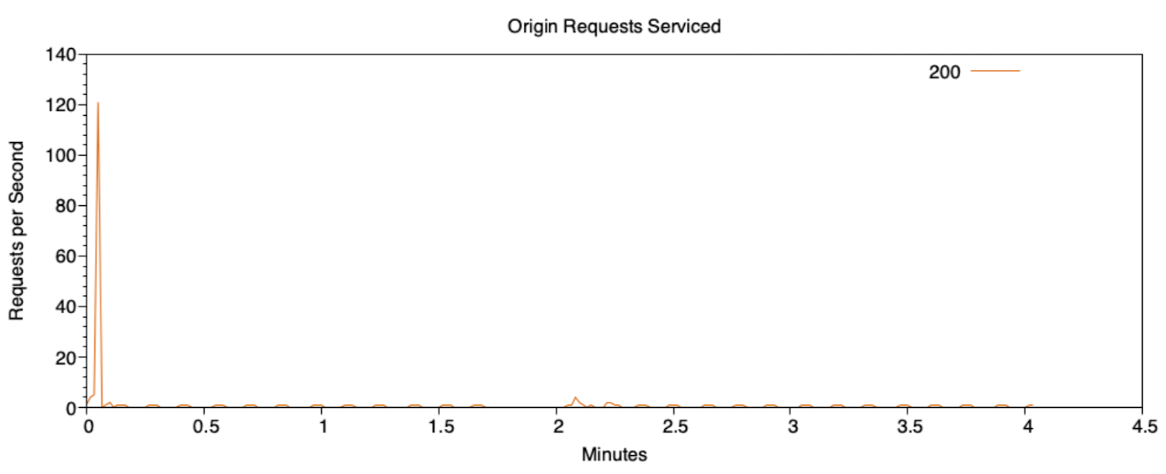
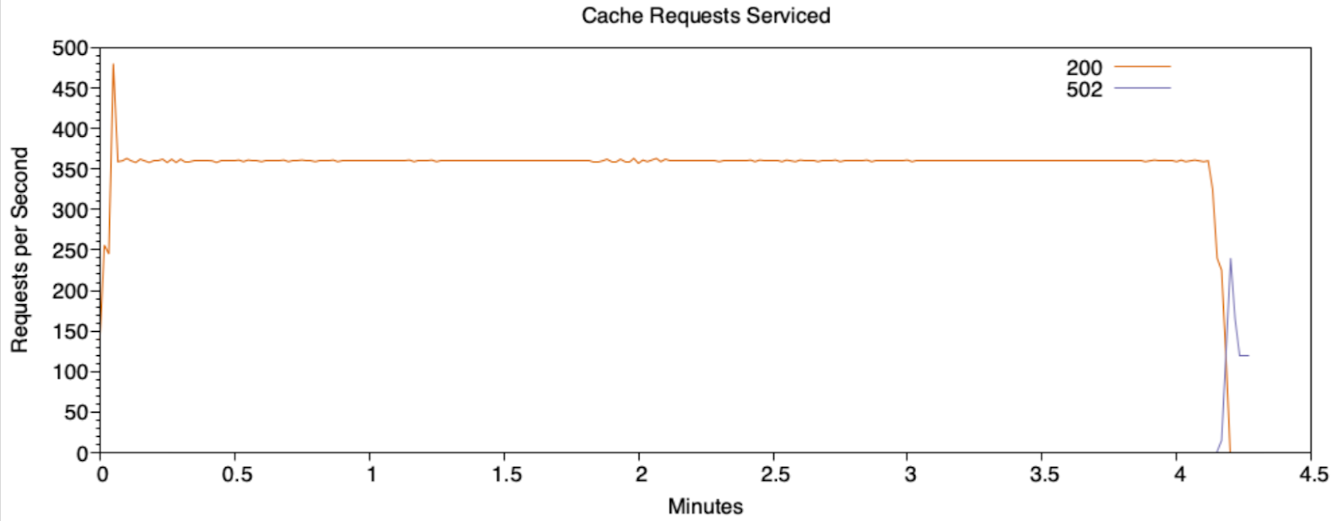
Retries
10 retries x 10ms
150 retries x 10ms

Slide 34
Production Testing
Settings changed
Slight uptick in ttms, but saving trips to the origin
Can mostly simulate collapsed forwarding (acts similar in testing)

Slide 35
Origin max connections

Slide 36
Limits the number of socket connections per origin
Solves many thundering herd issues by stopping the problem at the source, or at least the first the place it can be seen, by limiting connections on the Edge to the Mid
Still want to enable between tiers when possible, otherwise you can shift the herd from one tier to another
There is also an origin_max_connections_queue value. However at least for the linear scenario we could not find a use for it since all it is doing is effectively backing up more connections when you have already hit your limit, extending the herd

Slide 37
Limits the number of socket connections per origin server to the value specified
With no max we get a spike when the origin is disabled. Before this we are already hitting the origin hard
With a max set we never go above the limit. We start returning 503s while we are in the over connection condition
These graphs are a bit odd possibly just due to using iptables rules and stuck connections

Slide 38
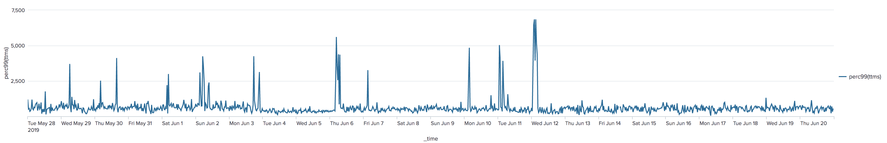
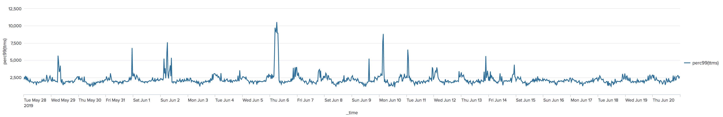
Origin max mso bug – beware ps/MSO use
TTMS (Time in ms spent processing the entire client request until last byte is delivered)
Origin
CDN (Edge to Mid)

Slide 39
2 Fixes available:
Problem is that when we enter a “throttled” state the functionality that is supposed to handle congestion does not exist in parent selection. So we end up looping in the state machine as we hit the bad state
Quick and dirty
Implement a 502 handler in ATS to immediately kick back to clients during congestion (over the max)
Fix parent selection (MSO) to handle 502 states and congestion properly
https://github.com/apache/trafficserver/pull/5650
Already in master, 8.x, and 7.x
Also recommend: https://github.com/apache/trafficserver/pull/5379
Possible to get stuck in a tight loop when hitting the total max connections on a machine
Easily pickable to 7.x

Slide 40
These mitigations work fine, until you have simultaneous requests
ATS depends on the headers being cached to consider an object as “In Cache”
If you have multiple simultaneous requests for the same object at the same instant you can still end up with a flood going to origin
ATS Open Read/Write retries and timing
When a request first comes in ATS will first attempt a read lock to determine if an object exists
For linear video you can end up with contention as you have multiple clients all trying to access fresh content at the same time
If the read lock fails (because the content does not exist) then a write lock is attempted
In this case if headers have not come back you can have multiple clients all waiting on the write lock. They will never go back for a read lock and so you still end up with a herd to the origin to update the same content multiple times
The Solution: Collapsed Forwarding (or Request Coalescing) & changing retries

Slide 41
collapsed forwarding

Slide 42
Problem Sequence:
Client requests object
Cachekey (hash of the request url) is generated
Key is checked for existence
If key does not exist, object not in cache or it is currently being fetched and headers have not been written
Attempts to grab write lock
Go to origin for object
If key exists
Grab read lock
Success – serve from cache
Failure – Obtain write lock and attempt to go to origin
The problem occurs when the majority of requests arrive before the headers have arrived back from the first request, so the object has no entry in cache. This can occur in a live video scenario with constant new objects and clients all following a live stream

Slide 43
Similar to the open read and write is collapsed forwarding
Currently available as a plugin in ATS
We (and others) have seen some issues with internal error codes leaking back to clients
WIP PR: https://github.com/apache/trafficserver/pull/5377
We have run (a slightly more up to date version) in production canaries when possible
Appears to help in the edge scenario greatly, >95% collapse rate
Mid usage saw almost no collapsing so this needs more investigation before it is ready
Code is fairly simple, returns to read lock check if within write retry limit
Much of this may change in the future, current discussions around re-working read and write locks/retries/etc to be done in a single state to alleviate many headaches

Slide 44
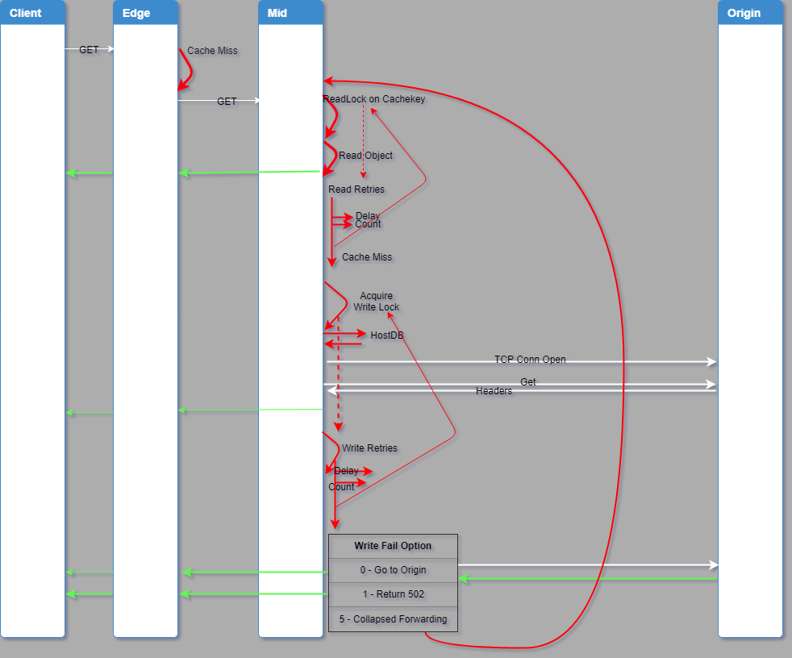

Slide 45
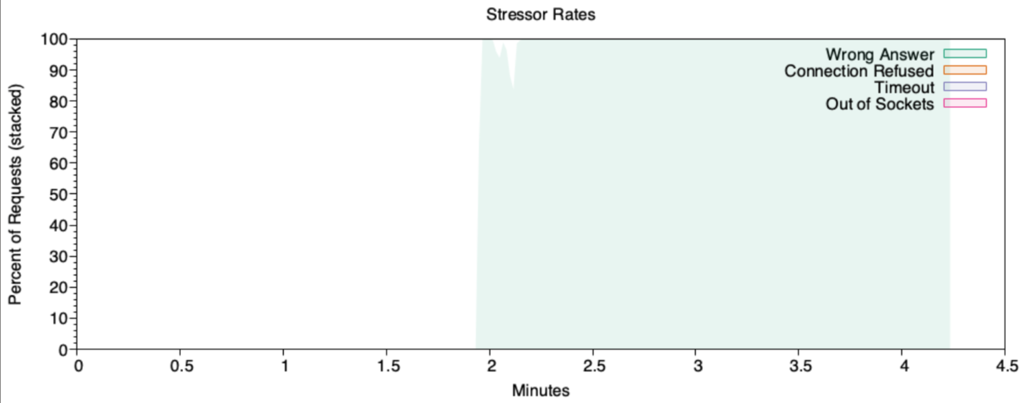
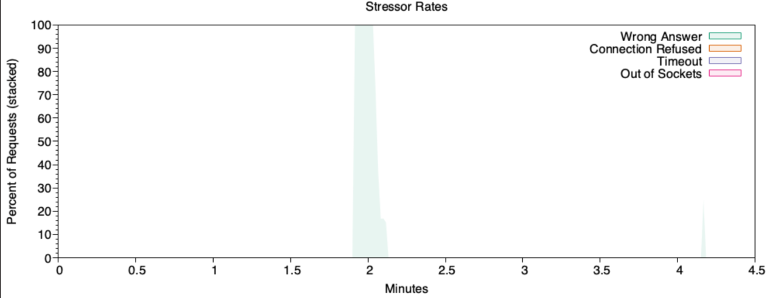
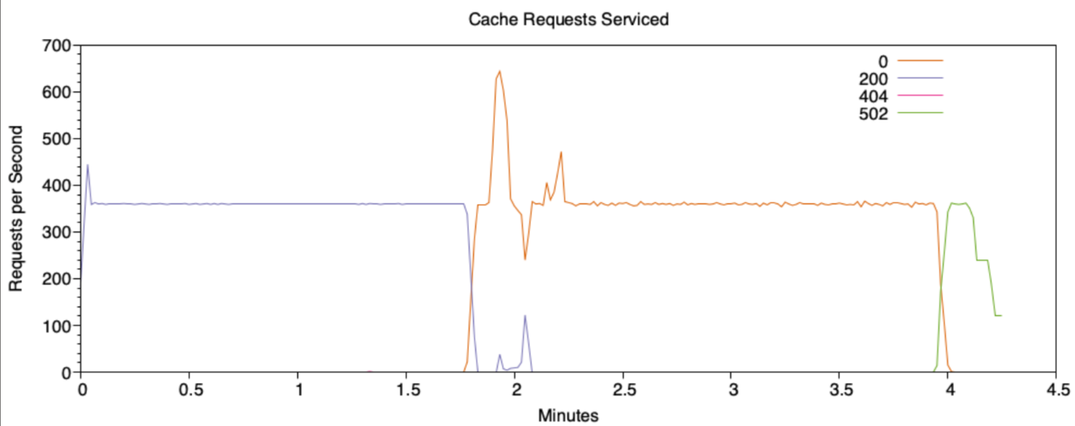
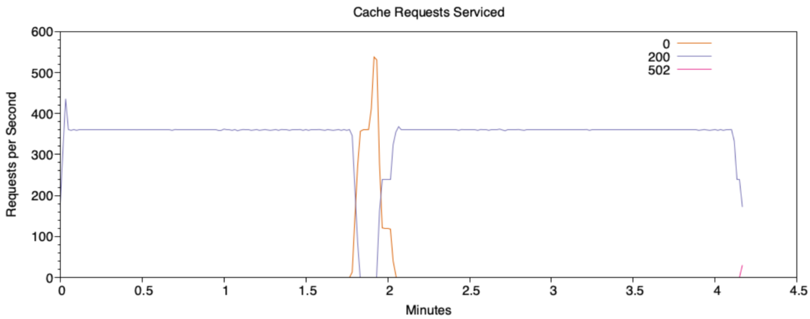
CF off
Other mitigations off
CF on with 5 read retries, 30 write retries
Other mitigations off

Slide 46
Settings to tweak

Slide 47
Transaction_active_timeout_in
Transaction_active_timeout_out
Connect_attempts_timeout
Connect_attempts_max_retries
Open_read_retry_time
Max_open_read_retries
Max_open_write_retries
Origin_max_connections
Read While Writer

